Slide 1
Company Bankruptcy Prediction NTU SC1015 Mini Project
By:Krishnadas Manoj, Cao Xing Ping, Keong Wee Kiat Edwin

Slide 2
Table of Content
Overview
Workflow
Data Sets
Model Selection and Evaluation
Results
Conclusion
References

Slide 3
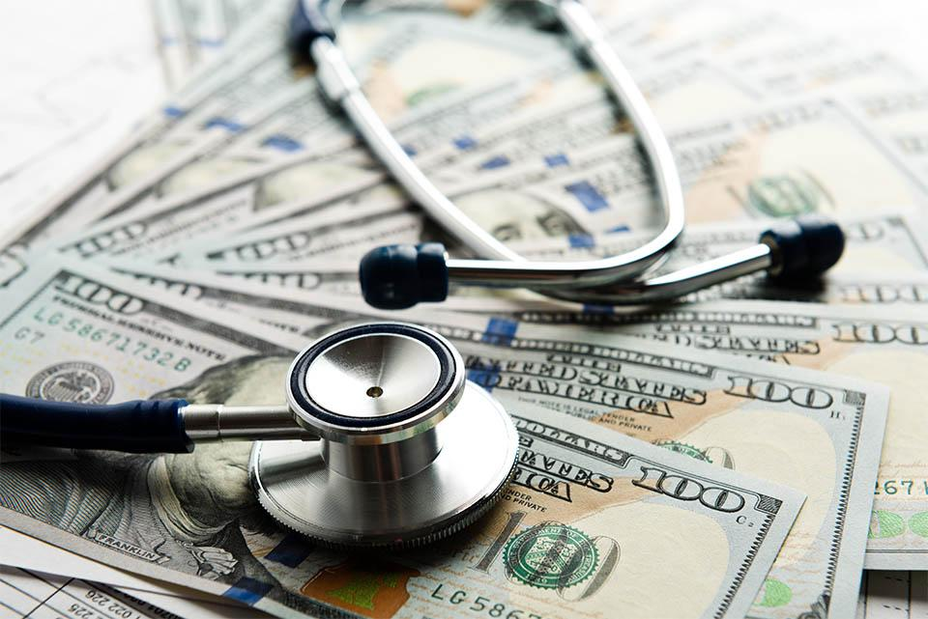
Overview
Bankruptcy affects the finances of all stakeholders.
The project uses machine learning models to predict bankruptcy using financial data.
Our Aim: By predicting the likelihood of bankruptcy, companies can take proactive measures to improve their financial health and avoid potential financial distress

Slide 4
Workflow
Understand the dataset and its features
Pre-process the data and standardize the financial ratios
Implement and evaluate different binary classification models
Compare the performance of the different models
Determine which model performs the best in predicting
Explore potential areas for future improvements

Slide 5
Data Preparation / Cleaning
Source – Company Bankruptcy Prediction (Kaggle)
Huge Dataset with a lot of information
Poses a challenge to analyze the data which results in slower performance and longer processing time
To identify critical predictors that are essential in determining the result
For example (Removal of outliers and using Confusion Matrix)

Slide 6
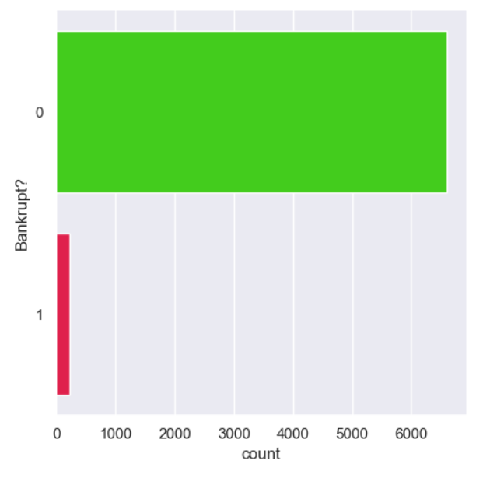
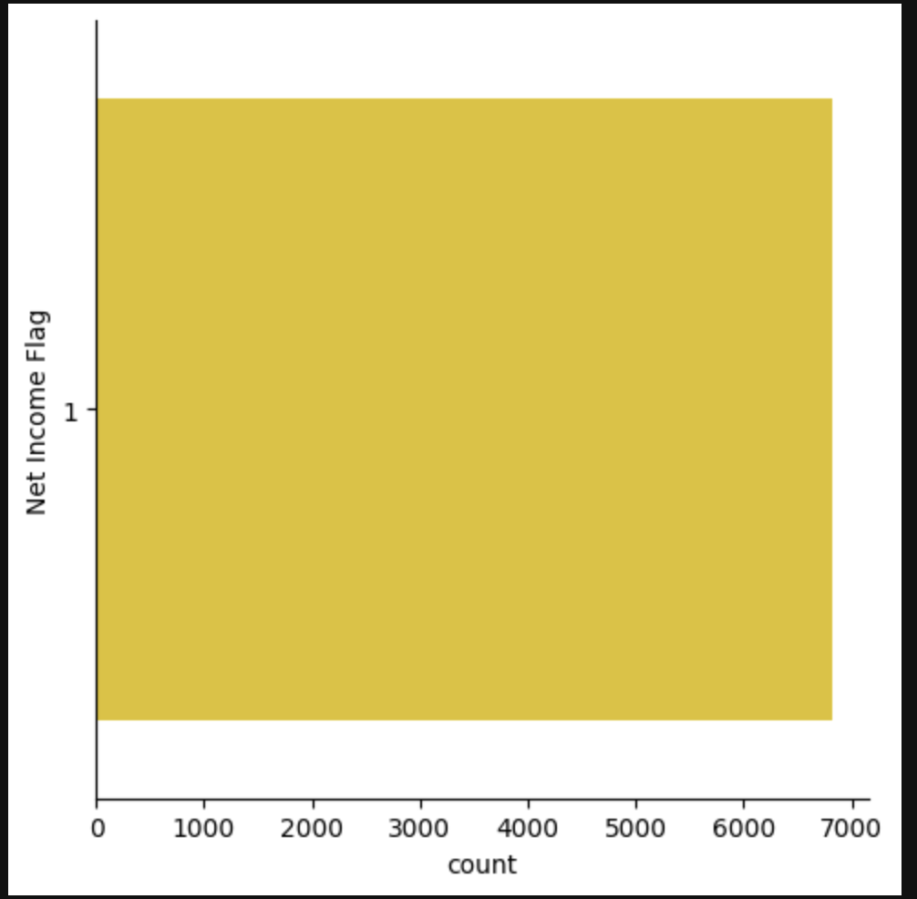
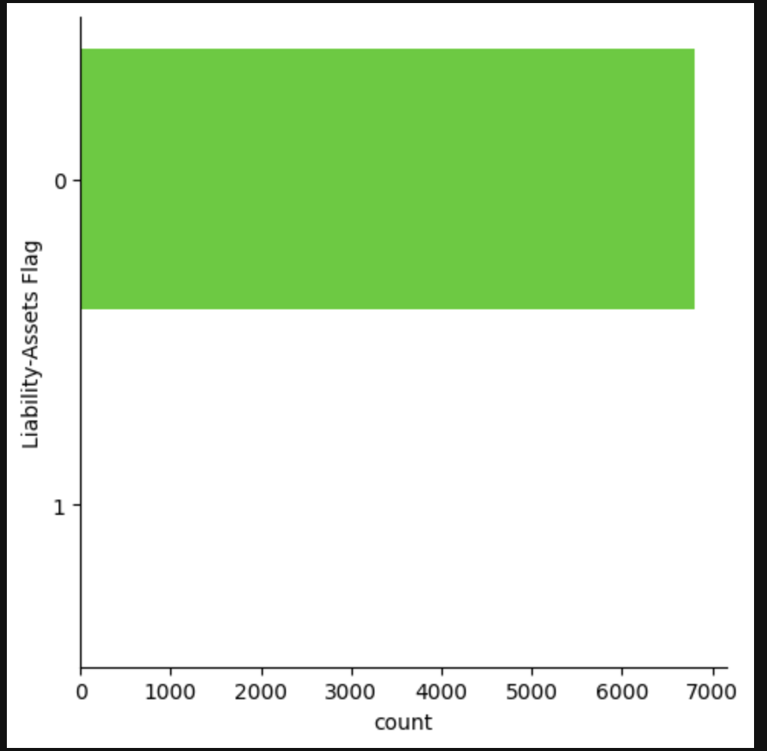
Data Exploration (EDA)
Highly imbalanced, may affect the performance of ML model prediction as results may be biased.
Show distribution of bankrupt and non-bankrupt companies (6599 vs 220).
Net-Income Flag and Liability assets Flag columns have only has only
one type of significant data.

Slide 7
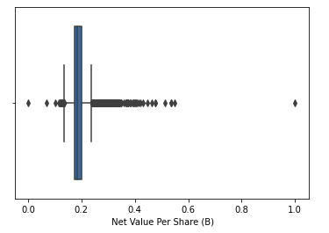
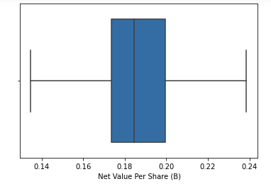
Outliers (Box Plot)
Significant number of outliers were seen in 89 out of the 92 columns of features that were in the dataset.
Removing outliers will lead to an increase in accuracy and a decrease in the false-negative rate
Logistic Regression, Random Forest and XGBoost classifier models handle outliers well.
Before
After
Notes:
The Logistic Regression model achieved a decent accuracy of 95.41% in predicting bankruptcy status
The values which were 3 SD. Away from the man values were removed. L.R, Random forests , XgBoost are inherently robust in handling outliers and they are able to split up the dataset into subsets effectively ignoring the outliers.

Slide 8
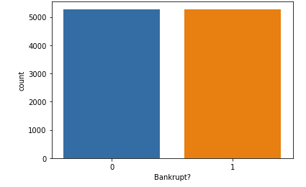
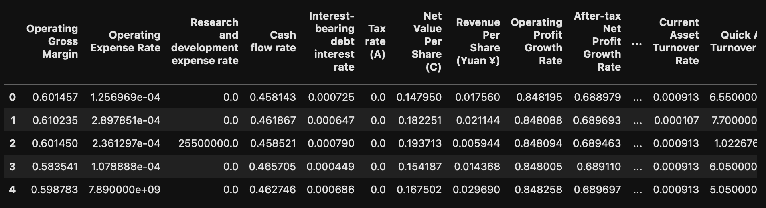
SMOTE and VIF
Imbalance of the target variable was fixed using SMOTE technique.
Reduce from 92 columns of predictor variables to 31 unique and independent variables
High multicollinearity between predictor variables can lead to unstable and unreliable regression coefficients, which can affect the accuracy of the prediction model.
Before
After

Slide 9
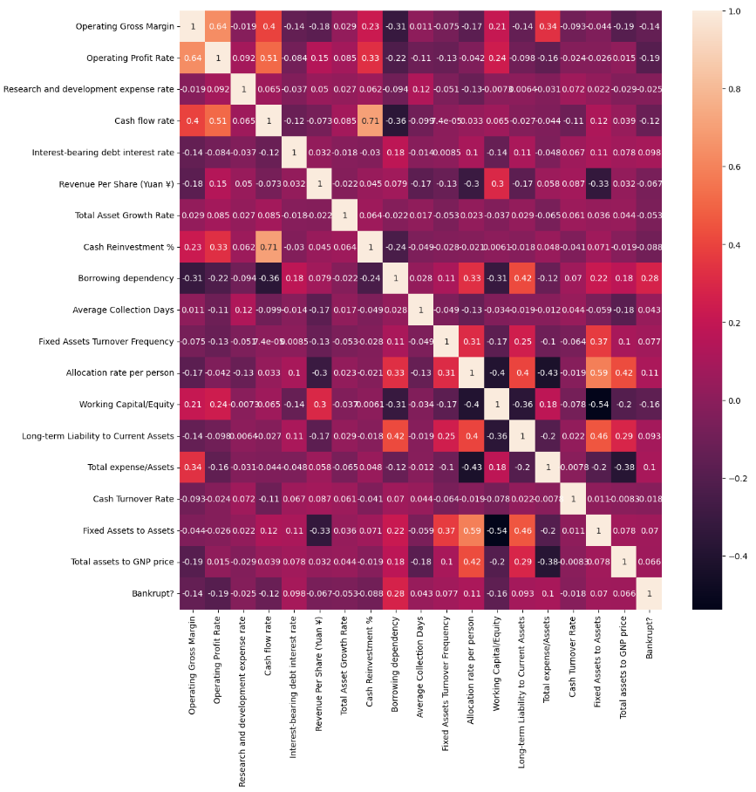
Correlation Matrix Heatmap
ROA(C) , operating gross margin, Net Income to Total Assets, have high positive correlation with bankruptcy status and may be good bankruptcy predictors.
Net income and current liability ratio have negative correlation with bankruptcy.

Slide 10
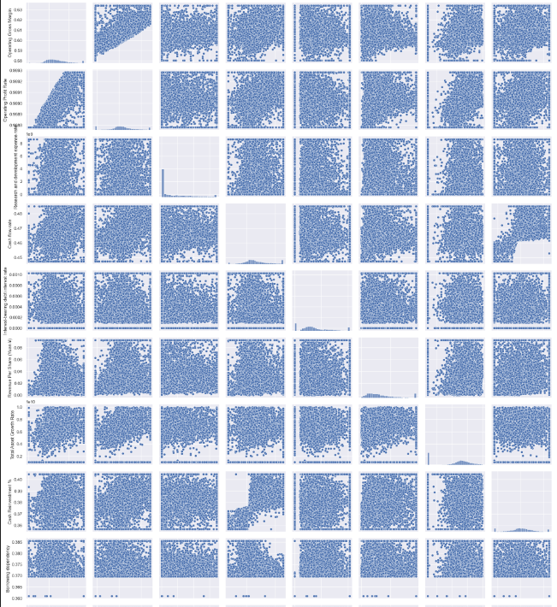
Feature Relationships
Most features do not separate bankrupt and non-bankrupt companies well
ROA(C) and Cash flow to total assets may be good bankruptcy predictors
Current ratio and quick ratio may require non-linear models for their relationship with bankruptcy

Slide 11
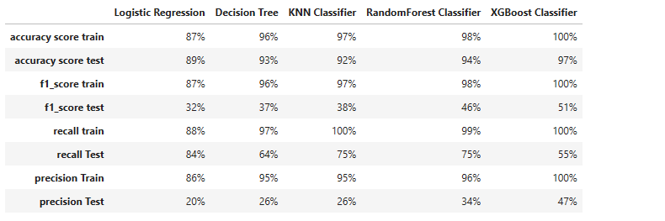
Model Evaluation
Evaluated models using precision, recall, and f1-score
XGBoost model performed the best overall

Slide 12
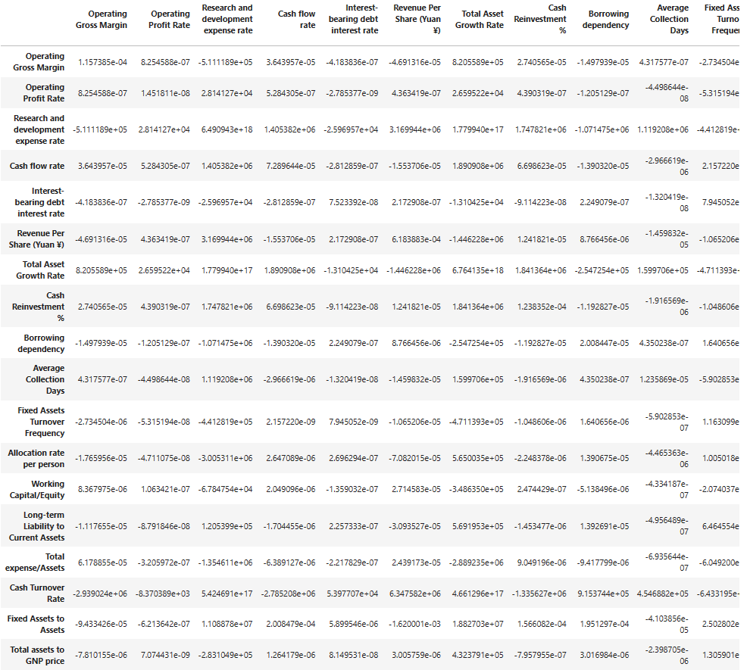
Feature Importance
It was calculated using the logistic regression model's coefficients, where larger absolute values indicate greater importance
Based on the regression model, there are 19 important predictors
Notes:
(Graph: Bar chart showing the importance of the top 10 features in predicting bankruptcy)

Slide 13
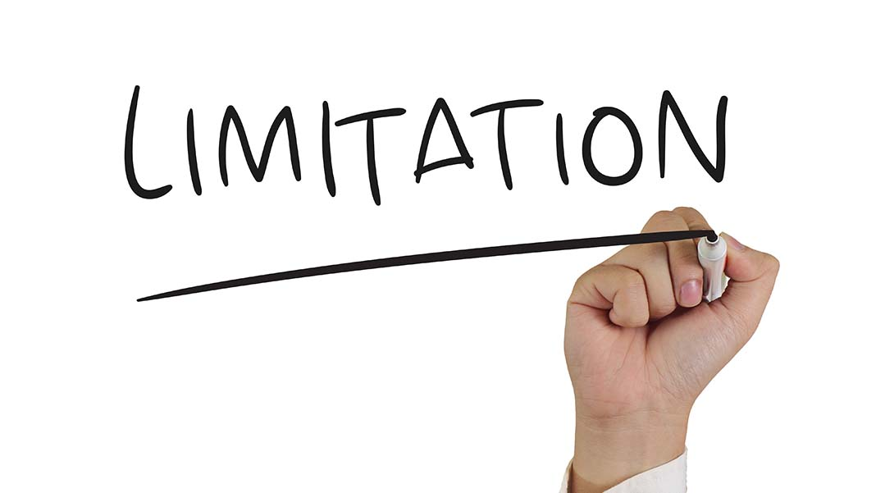
Limitations
Small Dataset
Imbalance Data- with only 4.4% of observations belonging to the bankrupt class
Time Horizon

Slide 14

Future Improvements
More advanced feature selection techniques
Hyperparameter tuning to optimize model performance
Trying different machine learning models or algorithms

Slide 15

Conclusion
Bankruptcy prediction shown accurate result with the model and feature
Useful for risk assessment in finance industry, investors and other stakeholders

Slide 16
Thank You!
CREDITS: This template was taken from Slidesgo, including the fonts

